Slide 1

OSCB Neglect Challenge Event
21st September 2021
3pm – 5.30pm

Slide 2
Introduction & Scene Setting
Lara Patel/Emma Leaver
How did we get here?
2016 Neglect task & finish group
2018 Ofsted full inspection
Peer Review
2020 Strategy group refresh
2021 Neglect challenge event!
Notes:
2016: Following child Q SCR - 2 yr commitment to raise profile of neglect & commitment across partnership; develop action plan; improve recognition, assessment & timely approach. Evolved into the Strategy Group with countywide operational group.
2018 –
Ofsted – cumulative effect, timeliness of identification & interventions - concluded that the response to neglect is not timely or effective for all children. Consequently a small minority of children remain living in unsatisfactory situations for too long
Peer review - colleagues from other LA’s and across the local partnership conducted a peer review – meetings, structured conversations & reviewed documents and tools. Identified strengths in leadership, tools, clear strategy and performance framework and good level of self-awareness. Challenged – too focussed on process and not outcomes; pathways too complex with too many tools; are we too focussed on naming neglect?
2020 - 3 operational groups & individual agency plans to improve ownership and impact

Slide 3
What the data tells us!
Steve Thomas

Slide 4
Early identification of neglect
Notes:
2nd year of monitoring activity around neglect
Identification remains low at early help stage but there are signs of improvement. The presenting factor abuse and neglect has been split into 2 so neglect alone can be selected in case of reluctance by partner agencies to record abuse.
Identification at the start of a child in need plan has improved but is still well below the national average
Proportion of new CP for neglect has been consistently higher than national average but appears to be reducing
The proportion of children becoming cared for fluctuates but is well below national average
There appears to be a steady increase in the proportion of children starting statutory plans who are known to early help services.

Slide 5
Use of neglect tools
Notes:
139 separate neglect tools were recorded on 1,574 child and family assessments completed in the first quarter of 21/22.
The proportion of Child Protection conferences where a multi-agency chronology informed decision making continues to improve. In the first quarter of 21/22 it was 66% for initial and 64% for review conferences compared with 29% and 51% respectively in the same period a year ago.

Slide 6
School attendance & exclusions
Notes:
Data relates to academic year 20/21 to the beginning of April
The worrying disparity between children in the 3 cohorts and rates for all school-age children remains.
Children starting a Child in Need plan recorded 3 times the overall absence rates of all children combined. Child Protection Plans and Children commencing a period of care had over 1 ½ times the rate.
Persistent absence rates were 3 times as high for children starting a Child in Need plan or period of care, and twice as high for Child Protection plans.
There is a very significant gap between the proportion of children in these groups who had attendance of less than 95% when compared with all children. Half of children with a new CP plan had less than 95% attendance.
No child starting a plan or a period of care received a permanent exclusion in the period, but 3 children starting a Child in Need plan and 1 commencing a period of care received a fixed-term exclusion in the school year.

Slide 7
Improving outcomes
Notes:
58% of Child in Need plans for neglect were completed within 9 months. No target has been set yet, and no comparative data is available
The proportion of Child Protection Plans for neglect completed in 18 months has increased again to 96% and is the same as for all other categories of abuse.
Of the 123 children with a new Child Protection Plans for neglect in the quarter, 36% (44) were a repeat plan.

Slide 8


Early help and identification-
Maria Godfrey, Jayne Harrison, Deborah Bell, Jonny Bradish
“The future will always change”

Slide 9
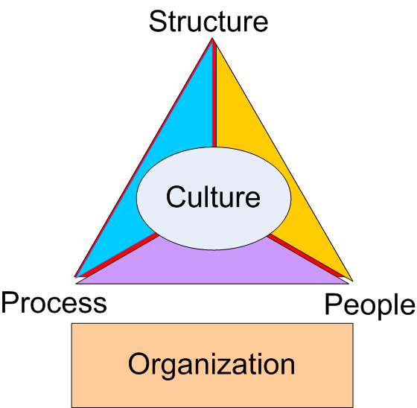
Early Help & Identification – an integrated approach
(Maria Godfrey/Jayne Harrison)
Neglect is not being identified early enough.
Data indicates low numbers of Early Help Assessments amongst some partners
Partnership review identified barriers:
Some practitioners view the Early Help Assessment as a cumbersome tool, to be used as a referral mechanism to access Children’s Social care
Practitioners report lack of clarity about when to use early help assessment processes
Lack of confidence on the part of some staff to engage with families around difficult issues
Strategic and operational support required
WHAT
WHEN
HOW
“Prevention key to neglect”
Cultural shift required
Notes:
Learning review evidencing severe neglect of two children could have been prevented if threshold need guidance had been understood and Early Help provided
Ensure that there is a cultural shift across universal services so that Early Help Assessments continue to be developed as a helpful multi-agency tool to use to understand a family’s story/provision of support services and that there are clear messages as to how an Early Help Assessment can help them.
Set up a multi agency Early Help Assessment Task and Finish Group to carry out a multi-agency review, take stock of where we are, identify what is going well and what are the challenges that need to be addressed to achieve a position where majority of practitioners use the early help assessment to achieve the above intention
Protecting children from neglect | NSPCC Learning

Slide 10
Early Help & Identification – an integrated approach
(Maria Godfrey/Jayne Harrison)
EHA Data 2020
Agency | 2020
Education – Primary | 609
Education – Secondary | 327
Nursery/Preschool | 26
LA Services – LCSS worker | 217
Health - Health Visitor | 44
Health - Midwives | 3
Health Services- other primary health | 35
Health – School Nurse | 6
Health - CAMHS | 27
Family – self | 30
Police | 2
Voluntary Sector | 3
Housing | 0
Data shows low numbers of EHAs from EYs partners (Nursery/Pre School/Health visitors/midwives ) as well as Police
Priority to address Early years due to importance of first 1001 days/school readiness.

Slide 11
Early Help & Identification – an integrated approach
(Maria Godfrey/Jayne Harrison)
Strategic expectations set out in Childrens Trust and CEDR performance frameworks to achieve year on increases of EHAs
Multi-agency group to review EHA form
Multi-agency Review EHA training
Increase online resources for practitioners and families
Threshold of need document has been updated
Bespoke early help training delivered to Police, Health Visitor service, plan in place for bespoke Midwifery training.
Bespoke Early help training and joint work with Early years services to raise awareness and embed use of Early help support within the sector
Actions
Notes:
1 At least 2000 EHAs to be completed in 2021/22
2 At least 200 Early Help assessments should be completed by health visitors in 2021/22
3 To increase number of EHA’s completed to 15000 by 2024/25 and by 2026/27 increase to 28,000 in line with poverty data.
Early years
Monthly Managers and Childminder meetings
LCSS attended to talk about EHA in Feb/March 2021 – this is now a monthly occurrence.
Regular Communications – fortnightly e-newsletter (2000 subscribers), Facebook, termly briefings, virtual visits on EHA by the Early Years team.
Annual safeguarding audit sent to 700 EY providers (And for first time) – specific questions on completion of EHA & contact with LCSS
Going virtual with EHA training for EY providers – greater reach, evening sessions, increased number of places
48% of settings said they had contacted LCSS in past year and 26% had completed an EHA
Numbers attending evening training up from 34 in Summer 2019 to 119 in Summer 2021
SEND
Information about use of EHA’s added into all of Early Years SEND training.
The message is that the graduated response is necessary for all children with SEND and for some children an EHA will need to be part of that graduated response.
EY SEN team offer ‘no names’ discussions for early years settings who to consider what action to take for children with emerging SEND. If relevant these discussions will include consideration of an EHA.
Information about the Graduated Response to be added to Help Assessment training to ensure settings get the same messages
LCSS have attended EYSEN Team meeting to ensure all staff have a comprehensive understanding of Early Help and the role of LCSS.
If EYSEN team member becomes aware that a setting is struggling to complete an EHA with a family; the team member will discuss contact with LCSS so that LCSS can offer support
Trained whole HV service inc NN
144 PCSOs trained across Ox this year

Slide 12
Early Help & Identification – an integrated approach
(Maria Godfrey/Jayne Harrison)
Extended remit of early help networks.
Agreement with CAMHS that families being closed to SPA are referred to LCSS if EHA/TAF required
Pathway for parents with additional needs developed and rolled out
LCSS and LADO service to provide 1:1 supervision for education staff
Neglect audit tool and action plans for schools developed
Multi-agency early years performance framework and dashboard being developed.
Strong relationship between children with disability team and LCSS
Actions continued
Notes:
TON provides greater clarity on when universal services should use early help processes to support families.
Pathway underpinned by TON Joint training for adult and Training to adult and children services
to ensure consistent messages about thresholds
Neglect audit tool developed by schools to identify neglect early being monitored through annual S157/175 return.
Anecdotal and data indicates that, as a result, staff are more confident in initiating difficult conversations and identifying neglect as an issue
monthly consultations ,joint training attendance at TAF meetings
Comment from Rachel Weston’s email:
Staff at John Henry Newman Academy were surveyed in July 2020 before training on Neglect was in place. A follow up survey was then conducted in September 2020 after the staff completed the Level 2 Awareness of Abuse and Neglect course. The survey contained some mis-information about what neglect is alongside true examples of types of neglect.
The survey in September 2020 showed an improvement in Knowledge and Understanding of Neglect. A few examples were (refer to table):
Neglect is…. Pre-training July 2020 Post training September 2020
Failure to provide an education 0% 87%
Being unresponsive to a child’s emotional needs 94% 100%
Failure to provide enriching experiences 46% 27%
Failure to protect a child from physical and emotional harm or danger 96% 100%

Slide 13
Early Help & Identification – an integrated approach
(Maria Godfrey/Jayne Harrison)
 | 2017 | 2018 | 2019 | 2020 | 2021 (To date)
Total EHA's | 1233 | 1480 | 1935 | 1684 | 1826
Year on year increases in completion of Early Help Assessments and increased TAF processes
Since Jan 2021 EHAs increase on 2020 figure and are already nearing the overall total of 2019.
Increase in early years EHAs
Community Early Help support in Oxfordshire:
1268 Children – Supported by LCSS
1160 Children supported through Community TAFs (led by partners)
577 EHAs currently being reviewed
3005 total Children being supported at Early Help Preventative level
Increase confidence reported
Impact
Notes:
Oxfordshire -year on year increases in completion of Early Help Assessments (dip 2020 due to covid) however despite this since Jan 2021 there has been an increase on 2020 figure and are already nearing the overall total of 2019.
Increased number of EHA’s from pre schools/nurseries: March –
EYS in 2020 EHA numbers = 28, to date 2021 = 44 total
HV in 2020 EHA = 44, to date in 2021 = 68
Confidence
High numbers aware of support that LCSS can offer (LCSS –EY Survey /OSCB Survey to be repeated annually)
by universal partners about when to use and how to engage families in Early help processes. (all above 85% in terms of knowing LCSS and EH)
Planned survey to agencies that have had bespoke training to ascertain confidence levels
CIN cases with EHA’s increasing still work to do on Child protection cases. Work in progress.

Slide 14
Early Help & Identification – an integrated approach
(Maria Godfrey/Jayne Harrison)
Challenges
How targeted Early Help services in Oxfordshire support families and prevent neglect
Neglect not sighted early enough. This often means a new or additional assessment is required by targeted early help before planning and SMART intervention can make a difference.
On-going analysis - To review the initial primary need code identified by MASH in the referral into CSC and whether this changes or not after an EHA is completed.
The impact of neglect is an issue that can be diluted and or masked due to greater presenting needs i.e. additional needs for children (ASD, ADHD) and this being enmeshed with the parenting capacity.
On-going analysis - Neglect feels disproportionally under represented in the casework being completed by targeted early help.
On-going analysis - An under representation of 0-5’s within targeted Early help which may mask the impact of neglect in early years and then present differently when children enter statutory education.

Slide 15

Early Help & Identification – an integrated approach
(Maria Godfrey/Jayne Harrison)
Actions & Impact:
Evolution training to all staff which includes chapter on identifying and addressing neglect. This is now mandatory induction to all new starters and business as usual.
Increased Service Manager capacity and influence – second service manager placed within targeted early help to address practice issues and improve interface between services.
Good conversations being held between targeted EH and LCSS where neglect is a concern – timely escalation within internal allocation meeting (without re routing back into MASH).
Accessible and visible consultations between Targeted EH and FSP to ensure timely escalation for statutory assessment.
Query – Are graded care profiles and other evidence based tools being used as a tool for escalation rather than impacting family improvement. Action - Tracking how many are being completed and analysing impact.
Focus on ensuring all plans are fully SMART (audit analysis shows this only occurs 37% of the time in RI cohort) and to ensure neglect is proportionately represented.
Focus on ensuring chronologies are up to date and evidence of genogram (audit analysis shows this occurs 61% of the time in RI cohort).
Continued improvement of interface between LCSS, targeted EH and FSP – Service manager staying close to practice and influencing escalations.
Next Steps:

Slide 16

Early Help & Identification – an integrated approach
(Maria Godfrey/Jayne Harrison)
How Health services in Oxfordshire support families at early help level and help prevent neglect
Challenge: low numbers of pre-birth EHAs completed
Action Taken:
Lotus team created to focus of needs of vulnerable pregnant women
Vulnerable pregnant women referred to HV for targeted & coordinated ante natal support
Bespoke whole service EHA training to be delivered to midwifery staff from end Sept.
Impact:
Better communication between midwifery and health visiting so that vulnerable women can be supported early
Expected increase in number of ante natal EHAs after training completed.
Notes:
Neglect pathway
Adolescent aide memoir
Neglect Practitioners Forum
Joint Activity Pathway
Joint working on TAFs
Attendance at early help networks
Joint work between Mental Health Support Services School Nurses and LCSS
Add in MHST and early network meetings
Joint work between MHSTs, SHNs and LCSS to support schools.
Neglect practitioners forum has broad health attendance.

Slide 17
Early Help & Identification – an integrated approach
(Maria Godfrey/Jayne Harrison)
Challenge - increasing the number of EHAs. Specific challenges around staff capacity, parental choice-viewed as social care process. Cultural shift.
How health services in Oxfordshire identify vulnerable children.
Pre-school 0-5 health visiting and FNP
Action taken:
Trained the whole HV workforce including nursery nurses.
EHAs offered to all UPP families (higher level of vulnerability)
HV service carry out lots of early help work e.g. parenting support,
support for school readiness, increased contacts for vulnerable families
Impact:
Significant increase in the number of EHAs completed over past year.
Early intervention leads to support for families and positive difference for children - SEE CASE STUDY
Notes:
Assessment at HCP core contacts to identify children at risk of neglect (inc. use of tools)
CNN packages of care to support parents around toilet training, positive parenting etc
HV pathway for parents with vulnerabilities with increased contact pattern
Antenatal visit for expectant mums scoring 3&4. Should include discussion with midwife, especially where there is non engagement
SEND pathway for parents with children with SEND with increased contact pattern
EHA training rolled out to whole service, including skill mix staff
EHA being offered to all UPP families (inc. all on pathway for parents with vulnerabilities and SEND)
Enhanced universal offer to support development to enhance school readiness
HV to SHN transition pathway
CNN packages of care – work prior to EHA, following package of care, may go back to universal provision or increase to UPP with identification of need for EHA and involvement of additional services
Pathways for parents with vulnerabilities: New pathway written and being introduced in the Autumn, to identify parents with vulnerabilities which may affect parenting, inc. learning disability, complex or long standing mental health. Increased visiting pattern inc. more intense support of parents with learning difficulties by skill mix staff in the early months. Children of parents with vulnerabilities will be given UPP level of service
SEND pathway – pathway for parents of children with SEND, will go onto UPP level of service and be offered increased contact.
EHA training: LCSS have provided additional training for all HV service staff inc. skill mix staff
EHA: To be offered to all families on UPP level of service (where additional services aren't presently involved.)
Huge increase in EHAs completed by
HV to SHN transition pathway:

Slide 18
How Education Services in Oxfordshire support families through early help processes and prevent neglect

Slide 19
Early Help & Identification – an integrated approach
(Maria Godfrey/Jayne Harrison)
Early intervention and prevention has avoided 282 permanent exclusions during 2019-21
Year | Total PEX | Early intervention
2019/2020 | 66 | No data
2020/2021 | 19 | 282
Notes:
Research and learning from CSPRs tells us that children are more at risk from neglect if poor school attendance is a feature in their lives. Exploitation risks are heightened when exclusion is a feature.
Action: EHA has been built into all attendance and exclusion processes, both within Learner Engagement Teams and when receiving referrals from schools. Schools must now complete EHAs prior to exclusion or making an Attendance referral. If they have not, reasons are sought by Learner Engagement Officers.
Impact: Having shifted the culture to recognising the benefits of early intervention and prevention, Learner Engagement Officers, working with schools, children and families, have prevented 282 exclusions since 2019. Of the 282, 102 were subjects of EHAs.
Over a 2 year period – could have had 282 children excluded
EHA now in exclusion notification form.

Slide 20
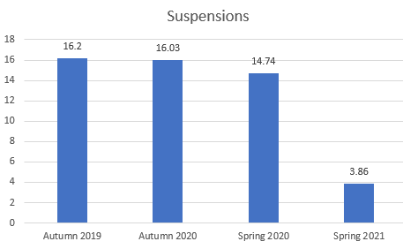
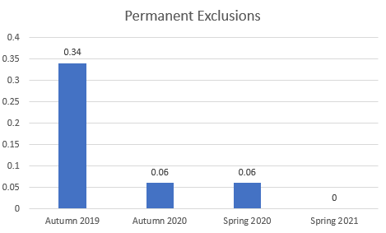
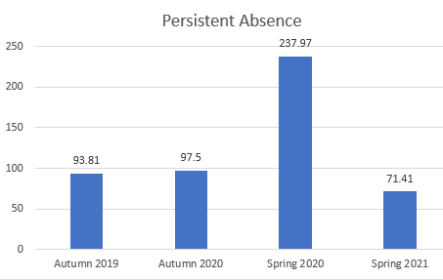

Early Help & Identification – an integrated approach
(Maria Godfrey/Jayne Harrison)
Restorative Practice
42 settings (10 secondary and 32 primary) received Restorative Practice training during 2020-21.
See below outcomes for RP trained schools:
Data is based on average figures.
Summer 2020 to Summer 2021 comparisons impacted by COVID-19 lockdown as no data available for Summer 2020.
Notes:
Action - recognising that relationships are key to better understanding underlying reasons for exclusion and poor attendance, a full restorative Practice training offer has been rolled out during 2020-21. Uptake exceeded target by 75%.By introducing a restorative mindset in schools has led to less suspensions and permanent ex and persistence absence. Ultimately meaning more children in school more of the time…which we know means less likely to fall into neglectful situations.

Slide 21
Early Help & Identification – an integrated approach
(Maria Godfrey/Jayne Harrison)
Recognising that Attendance is a whole system responsibility to optimise for children at risk of poor attendance
Action - Attendance and exclusions training with schools via Attendance Network meetings and In Year Fair Access Panels advocates for use of EHAs.
Education has been better wrapped into Neglect and Early Help training for all partners.
Education training has been delivered to 150+ CSC staff and managers
Impact as of 8th September 2021 (mindful that secondary schools have not all returned and Covid impact on untested primary school children)
Overall attendance - 89.4%
Primary - 94.3%
Secondary - 81.2%
Special - 90.0%
Attendance of pupils with social worker – 97.0%
This represents a positive start to the term, building on Oxfordshire exceeding national averages for attendance last academic year.
Training

Slide 22
Early Help & Identification – an integrated approach
(Maria Godfrey/Jayne Harrison)
Attendance Officers have been delivering door knocks and prevention case work during the pandemic to sight children deemed vulnerable when not attending school.
Action - Given that early help is now built into their processes, referral for EHA has been assured as required. C.250 have been recommended to schools by Learner Engagement Attendance Officers.
Impact
2019/20 academic year – Only Autumn term was published by DfE. Internal figure for Oxfordshire for terms 1-4 (as schools were closed for the majority of the rest of the year) 94.8%
2020/21 – Autumn term has been published. Oxfordshire 95.7%. National 95.3%
Provisional Oxfordshire figure for the whole year is 94.7%
Attendance
Notes:
Mediation with families/door knocks…. Supported children back to school. If Officers noticed concerns they followed procedures e.g. MASH/EHA

Slide 23

Early Help & Identification – an integrated approach
(Maria Godfrey/Jayne Harrison)
Impact
Improved outcomes for the children and their family
Diagnosis and support for 4-year-old
EHCP - specialist school place
Improvement in all children’s hygiene & bedtime routine
DLA application successful
Dad now actively involved with care of children
Mum has returned to work
The impact of Multi Agency EH work in preventing Neglect
Notes:
Brief details of situation for child (ren) and family:
Family consists of Mum, Dad, and 3 children, daughter aged 7, son aged 4 and baby son 11 weeks.
Family had moved to area to be closer to extended family.
Mum had miscarried the previous year and suffered with low mood.
Previous MASH referral completed by the school due to sons presentation and historical safeguarding concerns around neglect. 4 year old son arriving at school in dirty nappy and dirty feet..
Anonymous referrals x 2 to NSPCC relating to physical chastisement of older children, poor nutrition and poor living conditions.
HV identified concerns around parenting ability and potential parental learning difficulties’ limited reading and writing ability.
4 year old son behavioural concerns and being aggressive to staff and other children in pre-school.
4 year old son both speech and language and generalised global delay.
Poor home conditions, cramped flat, awaiting rehousing.
What did you do?
Complete Early Help Assessment with family.
Multiagency TAF, including Nursery, Pre-school, LCSS, HV, housing officer and parents
Referral to speech and language
Referral to paediatrician for ASD assessment.
Referral to physiotherapy for ‘tip toe’ walking.
Nursery nurse from health visiting team offered support with toilet training.
What tools did you use?
Threshold of needs Matrix
Ages and stages developmental, social and emotional questionnaires
BRSIC speech and language assessment.
What did other services do?
EH worker – PAMS assessment
Barrier/Challenges?
Parents learning diffiuclites and parental understanding and capcity.
Health visitor referred 4 year old son to Community paediatrics due to developmental concerns and an MDA assessment completed led to a diagnosis and support package.
EHCP completed for 4 year old son including a successful application for admission to a specialist school.
4 year old son regularly attending speech and language appointments
Reward/rota system set up at home to ensure the children are clean, tidy and are taking responsibility for their hygiene needs- this improvement has been witnessed by all agencies in the home and at school.
Mum communicates with school on a regular basis about their concerns and wants to make any changes that will improve outcomes for her children.
Family engaging well with all services they are working with.
Good routine implemented around bedtime for children.
Mum taking regular exercise to improve her mental health.
Family successfully applied for disability living allowance.
Mum seeking appropriate and timely advice from GP regarding any health concerns for the children.
Dad more supportive, additional support offered by extended family and neighbours.
Mum successfully returned to work following maternity leave.
Most recent TAF meeting – all agencies agreed they currently had no concerns.

Slide 24
Early Help & Identification – an integrated approach
(Maria Godfrey/Jayne Harrison)
Still lots to do
Continuous and relentless focus on importance of multi-agency responsibility to identify vulnerable children and families as early as possible and put the right support around them in a timely way to enable children to achieve potential & prevent escalation.
Heads of Service to review all case studies for themes to identify both good practice to share and practice gaps to be addressed
Senior Manager has been appointed to provide strategic focus lead and drive this work forwards next 12 months.
Gaps and future plans…

Slide 25
Questions & Discussion
Challenge Team

Slide 26

Evidence of impact for Children & Young People with complex needs & subject to higher levels of intervention
-----------
Delia Mann
Lucia Bell
Iain Roberts
Made a difference?

Slide 27

Complexity
- Successes Actions
- Impact
- Training and Audits
- Case Studies/Themes
- CSC Survey
- Continued challenges
- Next Steps
- Questions

Slide 28

Leadership Culture Practice
needed to shift – cumulative Neglect not understood nor the harm caused to children

Slide 29
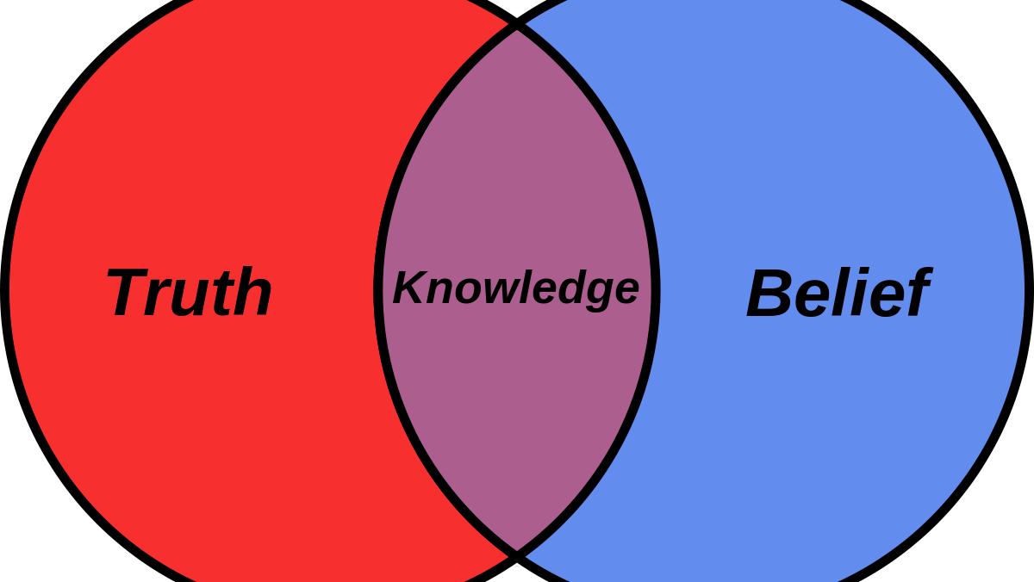
Multi-agency connection
Relationships
Data
Training and connected on priority – Health Education Police and Children’s Services

Slide 30
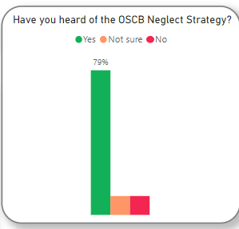
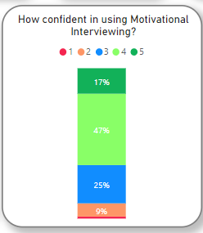
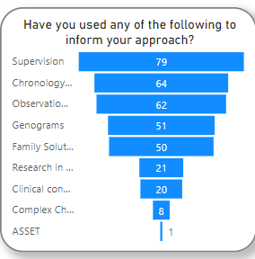
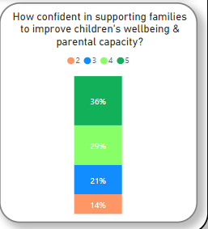
Survey……

Slide 31

Overall attendance - 89.4%
Primary - 94.3%
Secondary - 81.2%
Special - 90.0%
Attendance of pupils with EHCP – 87.6%
Attendance of pupils with social worker – 97.0%
Start of term
Sept 2021
very low number of EHE now on CIN/CPP due to neglect – less than 10 Heads of Service direct oversight of plan for each

Slide 32

Themes : improved use of GCP, supervision and plans more focused and precise in measures to reduce impact of neglect.
No evidence of joint visits - however good liaison following visits.
Poor attendance at school key issue improved evidence of contact with attendance service and % of attendance clearer in plans (rather than descriptors)
School participation in core groups high – core group actions and participation of all agencies variable
Majority of CIN plans had had historical involvement of CSC, repeated CAFA and generational neglect
Health visitor involvement with all CIN cases with under 5’s in family.
Impact: Audit Evidence – joint with health…..20 files viewed

Slide 33
Deep Dive into two children – Key recommendations
Reduce changes of social worker for children and families characterised by child neglect
Increase recorded evidence of management decision-making;
MACs to inform decision-making and Increase the use of MACs
Police attendance at ICPCs/RCPCs to increase
All agencies need to consistently consider the child’s lived experience and timescale when planning responses to neglect concerns
It is problematic if services/interventions’ availability is contingent on a child’s CP plan status
To establish a clear pathway for schools to refer to Health services if a health need is identified.
To be repeated in September with 4 children and focus on decision making, impact, multi-agency challenge, CP actions, effectiveness of core group
PAQA audit 28th September and 23rd November 2020.

Slide 34
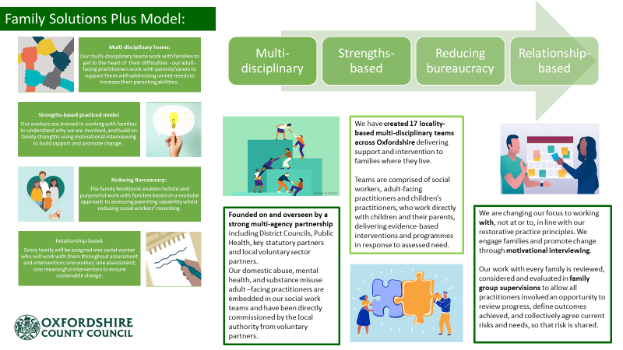

Slide 35
Data and categories: Impact
7children with CPP 2 years + across County
 | All CPP | Initial cat. Neglect
Aug-20 | 558 | 406 | 73%
Sep-21 | 545 | 342 | 63%
 | All ChIN plans | N1 Abuse & Neglect
Aug-20 | 1530 | 577 | 38%
Sep-21 | 1351 | 680 | 50%

Slide 36
Systemic Supervision
Delivery Within Children’s Disability
4 Systemic Training Sessions
Across 3 Teams
To + 43 Staff Members
Delivering +33 ongoing Systemic Supervisions
Covering + 100 Children
Hypothesising - rooted within Bateson's ideas
Circularity - not becoming ‘married to a hypothesis’
Neutrality – not placing blame and not taking sides

Slide 37


40 case studies submitted
All across CSC and Health – forensic detail – passion/tenacity for practice – increase use of tools/photos and more informed – child centred approach. MI visible
Thresholds and evidence base still an issue – as is language and perception of parental strengths but an improving picture
Missed opportunities present – FGC, connected people and therapy Teenage Pathways established across trusts and evidence of good liaison between services identified
Communication across multiple teams improved – use of Professional only meetings and presence on multi-agency panels to discuss intervention with families
Developing a lead professional role to coordinate and liaise with parents/carers and help navigate health systems.
One example of exploitation specialist nurse ,became key worker and worked alongside health services ,REOC, young person and family to increase positive outcomes.
All trusts have ‘was not brought guidance’ and evidenced use of this in cases where children not able to access health care
Contextual safeguarding recognised in case work when working with complex cases.
What case
studies told us:
This Photo by Unknown Author is licensed under CC BY-SA

Slide 38
Neglect Task and Finish group developed a Neglect tool Kit : Adolescent Aide Memoire, Neglect Pathway and Five points of Neglect Poster – and at a glance prompt

Slide 39

Childcare Development checklist in electronic form on community and mental health electronic systems and now able to report on numbers completed across the trust.
Beginnings of Joint Supervision of cases with children across all age ranges – SHN’S, HVs, Adult Mental health teams and specialist teams.
CAMHS – Involvement with CAMHS social work team forum around neglect.
Conferences for practitioners focussing on neglect took place over the last 18 months focussing on identifying neglect, language used and the use of assessment tools.
Training on a range of tools including Motivational interviewing approaches for all HVs
Impact Health

Slide 40
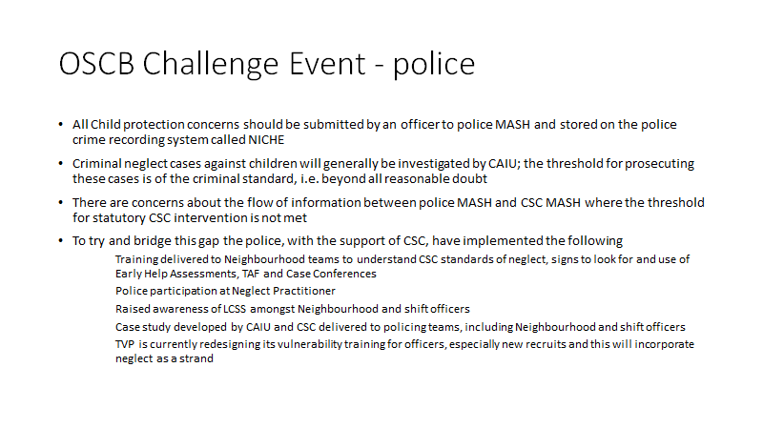

Slide 41

Joint visit protocol to be launched – joint visits to be part of all plans and if not occurring then recording of why not required. CSC Mandate CDC in CAFA where neglect key issue of concern and noted in 10-day review
CWCF – parenting/child experiences – joint work with Early Help on parenting programs and sessions to equip young people for parenting
CSC Review case study findings on approaches in CSC with Early Intervention leads
Continued Audits – measure change
Survey for partners – impact and sense check on training
CSC Pick list of tools (PAM GCP) for case note – so can be reported on and target – new record of action log for partners – launch imminent.
Monitoring of data – for trends following introduction of FSP
Next steps: much still to do…..

Slide 42
Questions & Discussion
Challenge Team

Slide 43
Key emerging themes
Professor Jan Horwath

Slide 44
Problem Solving & Next Steps

Slide 45
Thank You & Close

